Slide 1
Lecture 08 – Classification Models
Prof. André Gustavo Hochuli
gustavo.hochuli@pucpr.br
aghochuli@ppgia.pucpr.br
Notes:
Prof. André Hochuli

Slide 2
Topics
Discussion of Lecture #07
Image Descriptors
Classification Models
K-NN, Logistic Regression, Decision Trees Naïve Bayes, SVM and MLP
Evaluation Metrics
Accuracy, Precision, Recall and F1-Score
Practice
Computer Vision - Prof. André Hochuli
Lecture 08
Notes:
Prof. André Hochuli

Slide 3
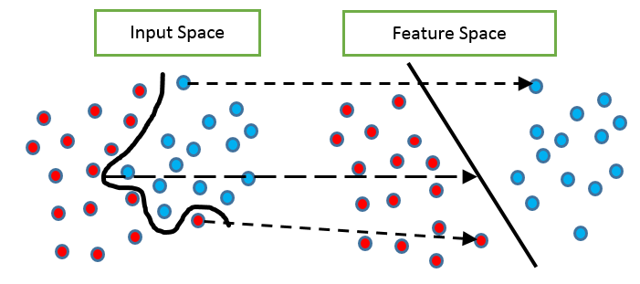
Problem
So far, we extracted features from data to compute the feature space
Computer Vision - Prof. André Hochuli
Lecture 08
Notes:
Prof. André Hochuli

Slide 4
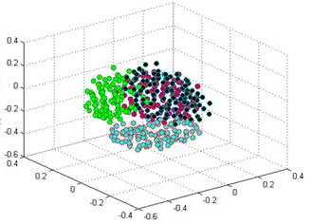
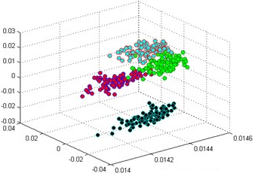
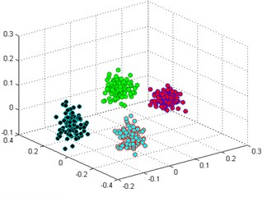
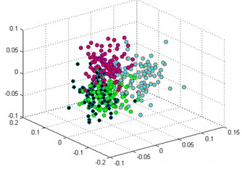
Problem
How discriminative features are?
Input Space
Feature Space’
Feature Space’’
Feature Space ’’’
Computer Vision - Prof. André Hochuli
Lecture 08
Notes:
Prof. André Hochuli

Slide 5
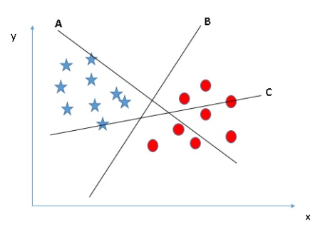
Problem
How to compute the decision boundary?
Computer Vision - Prof. André Hochuli
Lecture 08
Notes:
Prof. André Hochuli

Slide 6
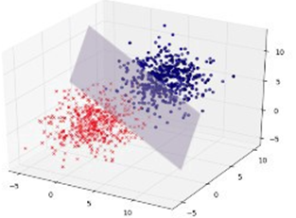
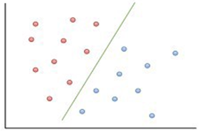
Problem
Hyperplane
2-D, 3-D … N-D (or N-Features)
Computer Vision - Prof. André Hochuli
Lecture 08
Notes:
Prof. André Hochuli

Slide 7
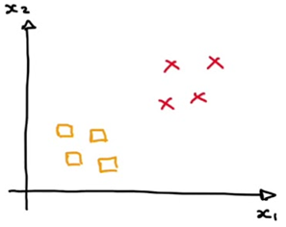
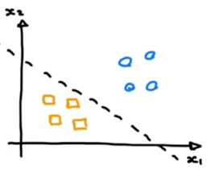
Problem
Binary Classification vs Multi-Class Classification
Computer Vision - Prof. André Hochuli
Lecture 08
Notes:
Prof. André Hochuli

Slide 8
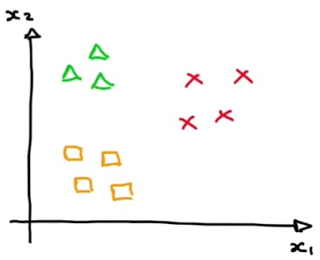
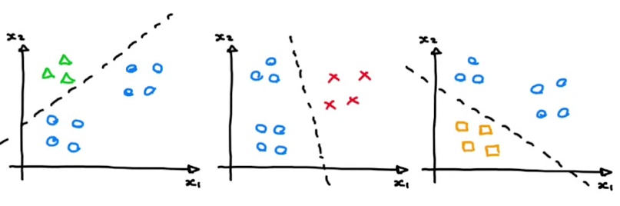
Problem
Binary vs Multi-Class
Computer Vision - Prof. André Hochuli
Lecture 08
Notes:
Prof. André Hochuli

Slide 9
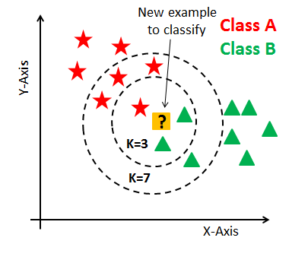
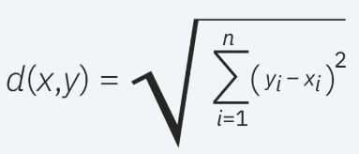
Classification Models
KNN
Computes the similarity in a feature space (Euclidian Distance, Manhattan….)
The K-Nearest Neighbors determines the class (Majority Vote)
There is no training step. Compute the distance of the test sample to each training sample
Computer Vision - Prof. André Hochuli
Lecture 08
Notes:
Prof. André Hochuli

Slide 10
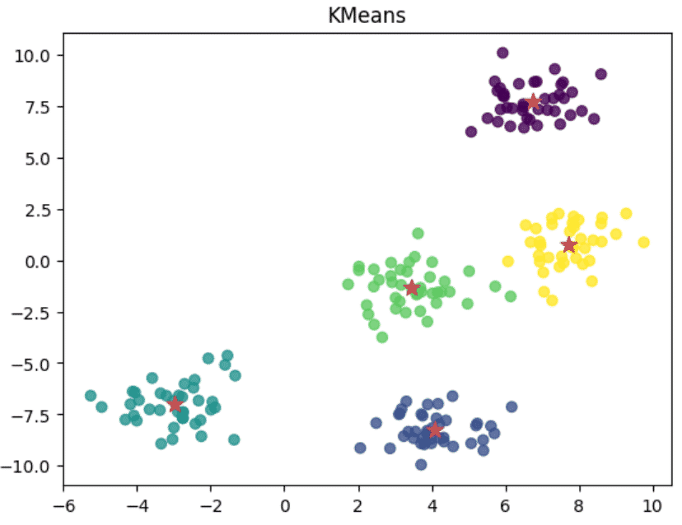
Classification Models
K-Means
Computes the distance between k-cluster
The clusters are defined in training step
Computer Vision - Prof. André Hochuli
Lecture 08
Notes:
Prof. André Hochuli

Slide 11
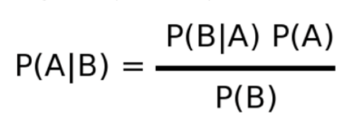
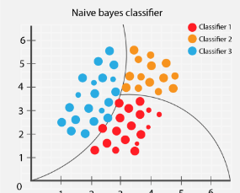

Classification Models
Naïve Bayes
Bayes Theorem
A priori vs Posteriori Probabilities
Computer Vision - Prof. André Hochuli
Lecture 08
Notes:
Prof. André Hochuli

Slide 12
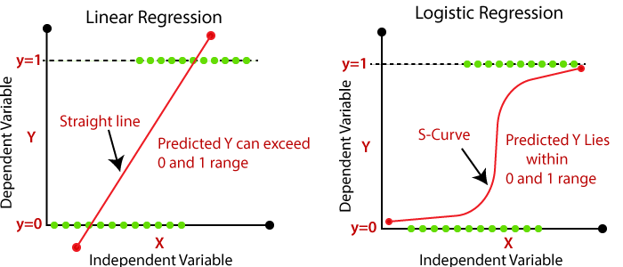
Classification Models
Logistic Regression
Linear vs Logistic
Computer Vision - Prof. André Hochuli
Lecture 08
Notes:
Prof. André Hochuli

Slide 13
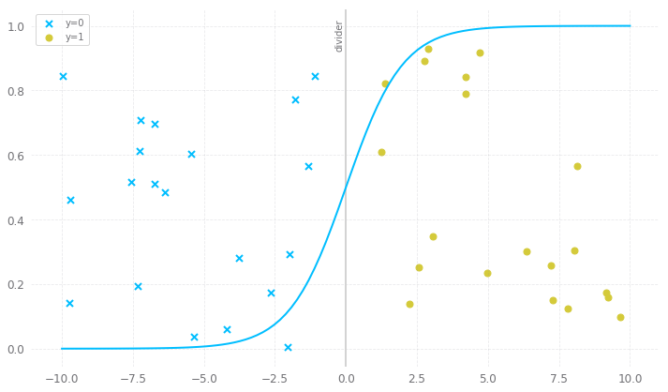
Classification Models
Logistic Regression (LR)
Logistic Boundary
Computer Vision - Prof. André Hochuli
Lecture 08
Notes:
Prof. André Hochuli

Slide 14
Classification Models
Logistic Regression (LR)
Logistic Boundary
Computer Vision - Prof. André Hochuli
Lecture 08
Notes:
Prof. André Hochuli

Slide 15
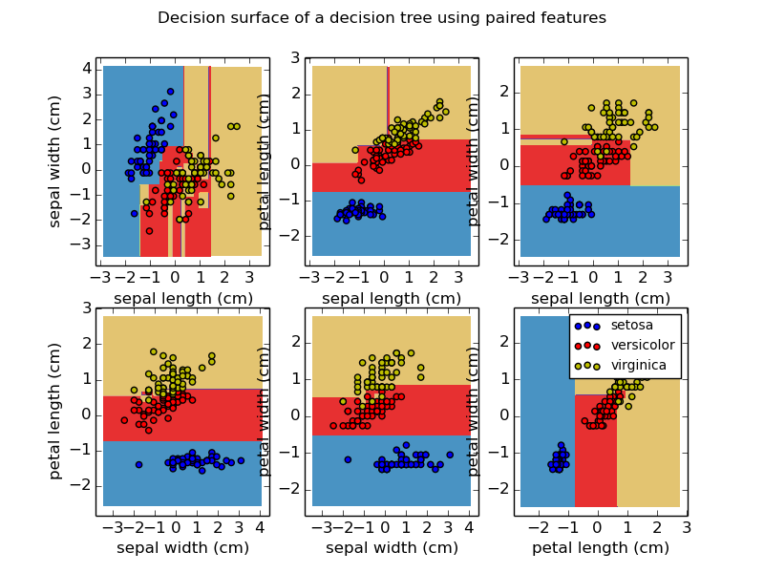
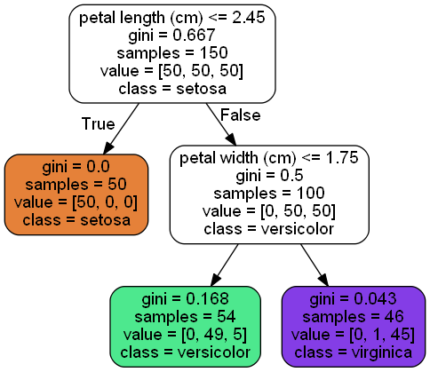
Classification Models
Decision Tree
Creates decision rules direct from the data features
Computer Vision - Prof. André Hochuli
Lecture 08
Notes:
Prof. André Hochuli

Slide 16
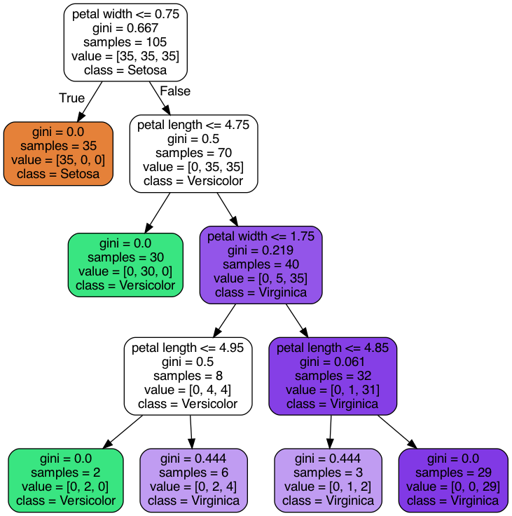
Classification Models
Decision Tree
Computer Vision - Prof. André Hochuli
Lecture 08
Notes:
Prof. André Hochuli

Slide 17
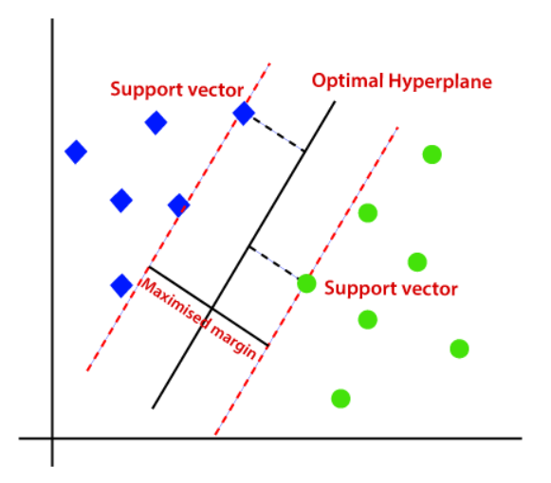
Classification Models
Support Vector Machine (SVM)
Compute Kernel: Linear, RBF, Poly or Sigmoid
The clusters are defined in training step
Computer Vision - Prof. André Hochuli
Lecture 08
Notes:
Prof. André Hochuli

Slide 18
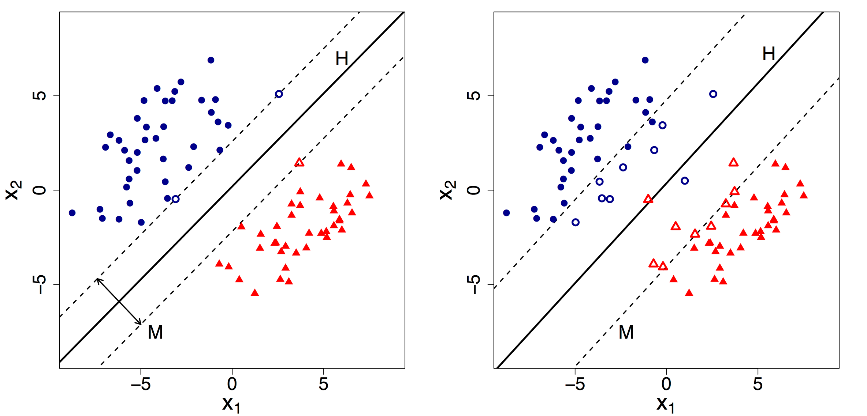
Classification Models
Support Vector Machine (SVM)
Hard Margin
Soft Margin
Computer Vision - Prof. André Hochuli
Lecture 08
Notes:
Prof. André Hochuli

Slide 19
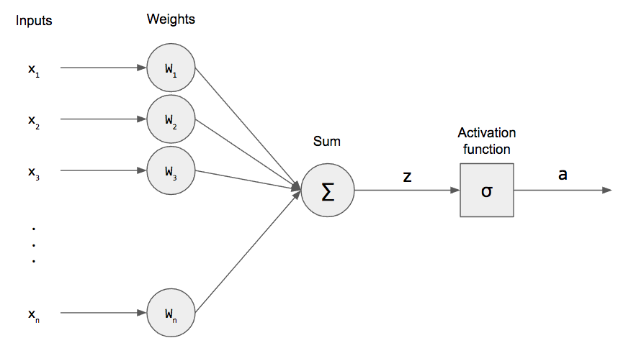
Classification Models
Multi-Layer Perceptron
Perceptron
Computer Vision - Prof. André Hochuli
Lecture 08
Notes:
Prof. André Hochuli

Slide 20
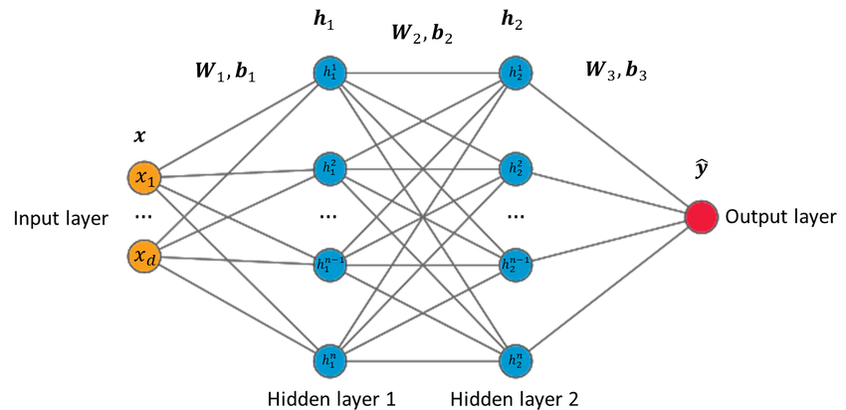
Classification Models
Multi-Layer Perceptron
Multi-Layer Perceptron (MLP)
Computer Vision - Prof. André Hochuli
Lecture 08
Notes:
Prof. André Hochuli

Slide 21
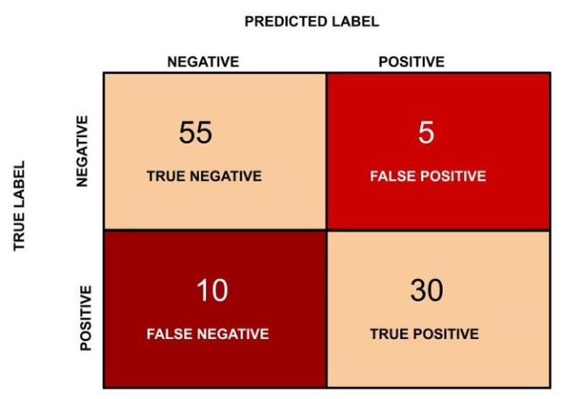
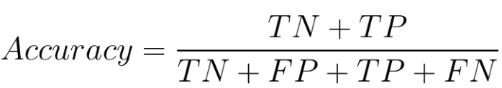
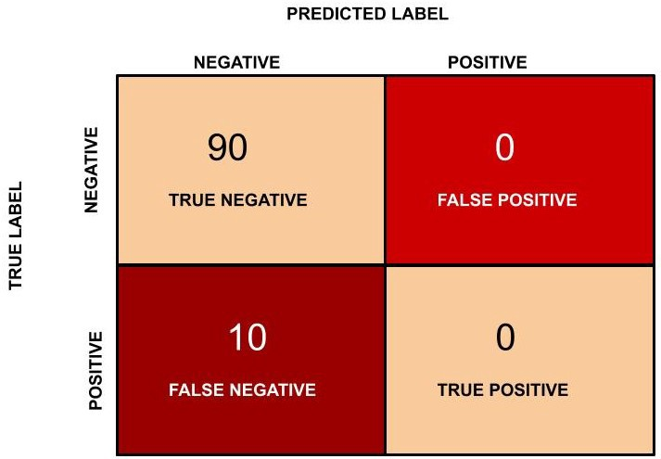
Evaluation Metrics
Accuracy:
Correctly classified instances over total instances
(55 + 30)/(55 + 5 + 30 + 10 ) = 0.85
What is the problem with accuracy?
Imbalanced Data
Acc: 90% (90/100)
Error TP: 100% (10/10)
Computer Vision - Prof. André Hochuli
Lecture 08
Notes:
Prof. André Hochuli

Slide 22
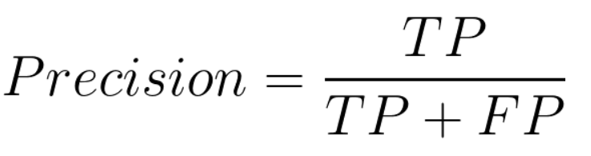
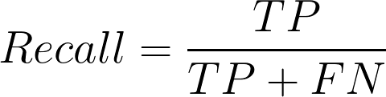
Evaluation Metrics
Precision:
Correctly positive classified instances over
positive predictions
30/(30+ 5) = 0.857
Recall
Correctly positive classified instances over
positive instances (A.K.A Sensitivity or TP Rate)
30/(30+ 10) = 0.75
Computer Vision - Prof. André Hochuli
Lecture 08
Notes:
Prof. André Hochuli

Slide 23
Let’s Code!
Lecture 08 - Image Classification.ipynb [LINK]
Computer Vision - Prof. André Hochuli
Lecture 08
Notes:
Prof. André Hochuli

